Slide 1
Core Java

Slide 2
Contents
Introduction
Keywords in Java
OOPs Concept
  Abstraction
  Encapsulation
  Inheritance
  Assosiaction
  Aggregation and composition
Exception Handling
Collections
MySQL

Slide 3
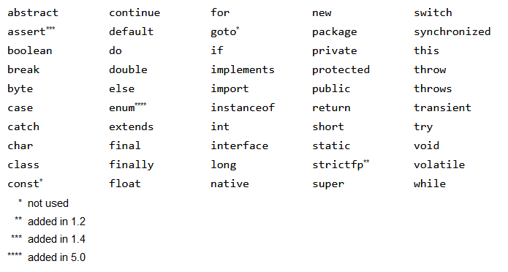
Keywords In Java

Slide 4
OOPs Concepts
Abstraction – hiding internal details of component.
Encapsulation – Access modifiers
Inheritance
Association – 1-2-1, 1-2-*, *-2-1, *-2-*
Aggregation and composition

Slide 5
Exception Handling
Checked Exceptions – checked at compile time
Unchecked Exceptions – checked at run time

Slide 6
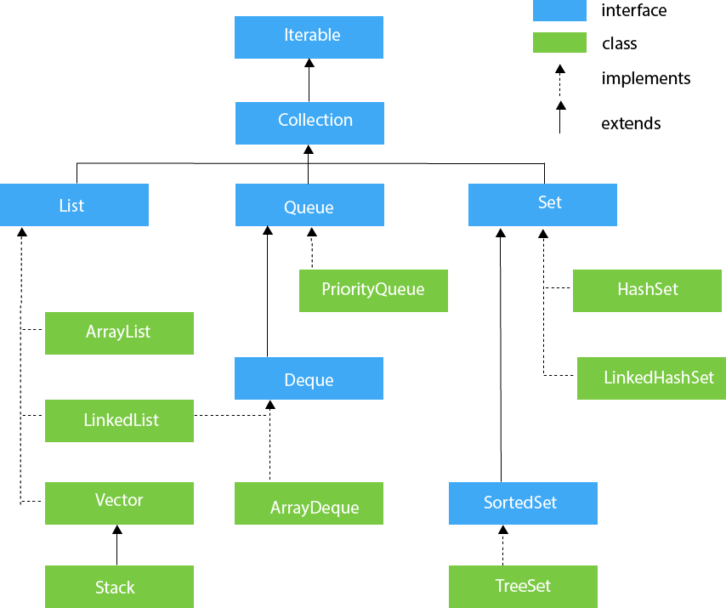
Collections

Slide 7
Collections

Slide 8
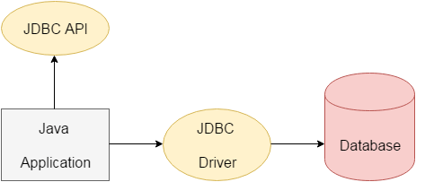
MySQL with JDBC

Slide 9
Thank You

